Slide 1
Placement Management
System
Project guide : Amrudha.D
Created by
Ragavi S

Slide 2
ACKNOWLEDGEMENT
It gives all of us great pleasure in presenting the preliminary project report on “Placement Management System”. With due respect and gratitude we would like to take this opportunity to thank the internal guide of our project Mrs.Amruta Deore for giving us all the help and guidance we needed.

Slide 3
We are really grateful for this kind support. She has always encouraged us and given us the motivation to move ahead. She has put in a lot of time and effort in this project along with us and given us a lot of confidence. Also we wish to thank all the other people who have helped us in the successful completion of this project.

Slide 4
ABSTRACT
Placement management will provide an opportunity for students and graduates to learn new skills. They are trained on programming skills like Java, C, C++, python etc., front-end technologies, JDBC, Spring, MySQL, hibernate etc., so that they meet the requirements of industries and are eligible for the hiring process.

Slide 5
1.1 INTRODUCTION
The objective of Placement management is to allow the students and graduates to register online for the course they wanted to learn. It also facilitates placement guidance to get placed in a company.

Slide 6
1.2 System Requirements
1.2.1 Software Requirements
Operating System - Windows 10.
Platform – Eclipse, MySQL,Servlet.
3.Language – HTML, CSS, Java, SQL.

Slide 7
1.3 MODULE
1.3.1 S Login
Login module will help in authentication of user accounts .Users who have valid login id and password can only login into their respective accounts.

Slide 8
1.3.2 Registration
This module will help the user get registered from anywhere if the internet is present .This module will really simplify the task of on paper registration..

Slide 9
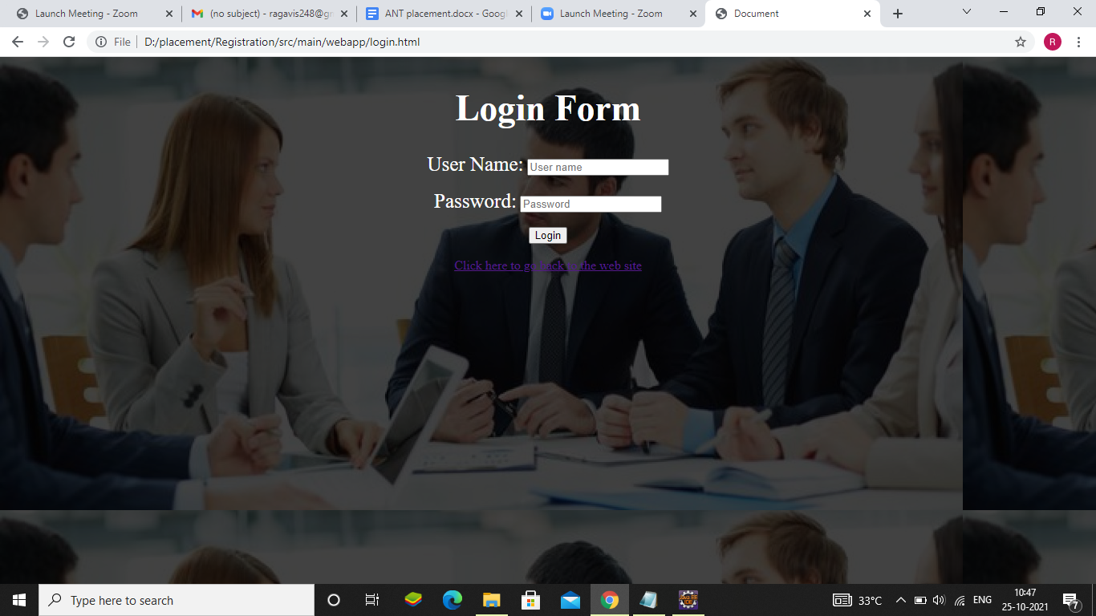
Login Page

Slide 10
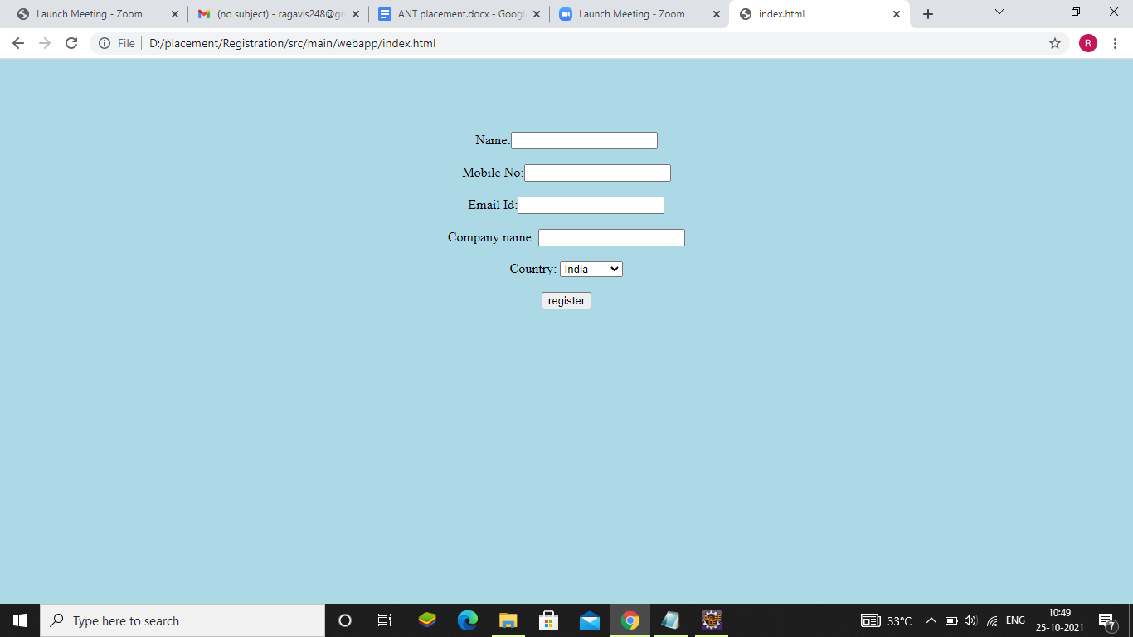
Company Register

Slide 11
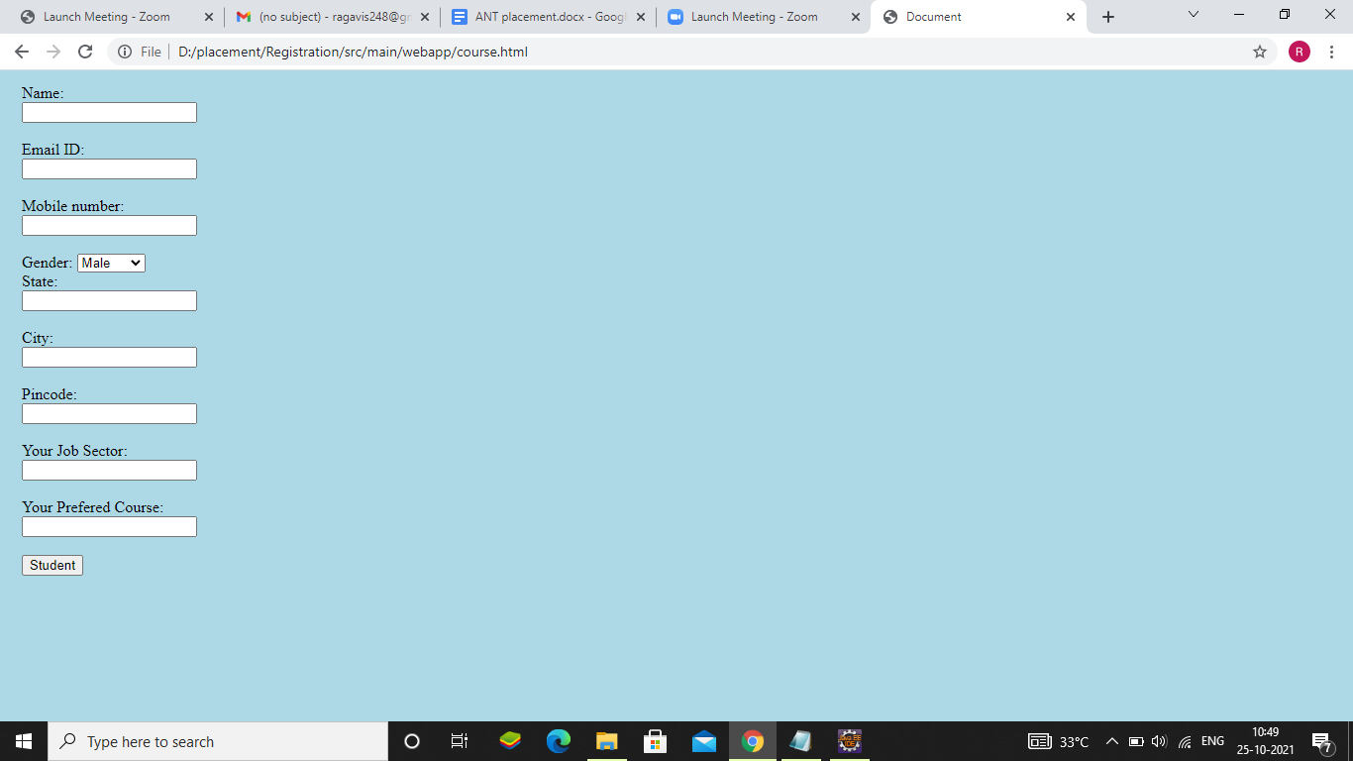
Course Register

Slide 12
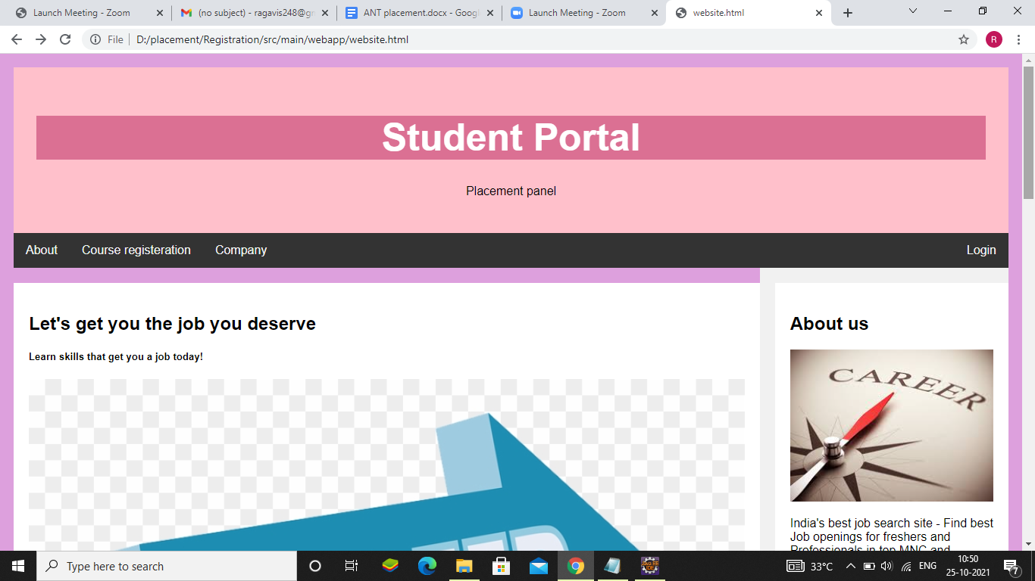
Home page

Slide 13
THANK YOU

